Slide 1
Cotwin
Idea, opportunities and next step

Slide 2



Slide 3
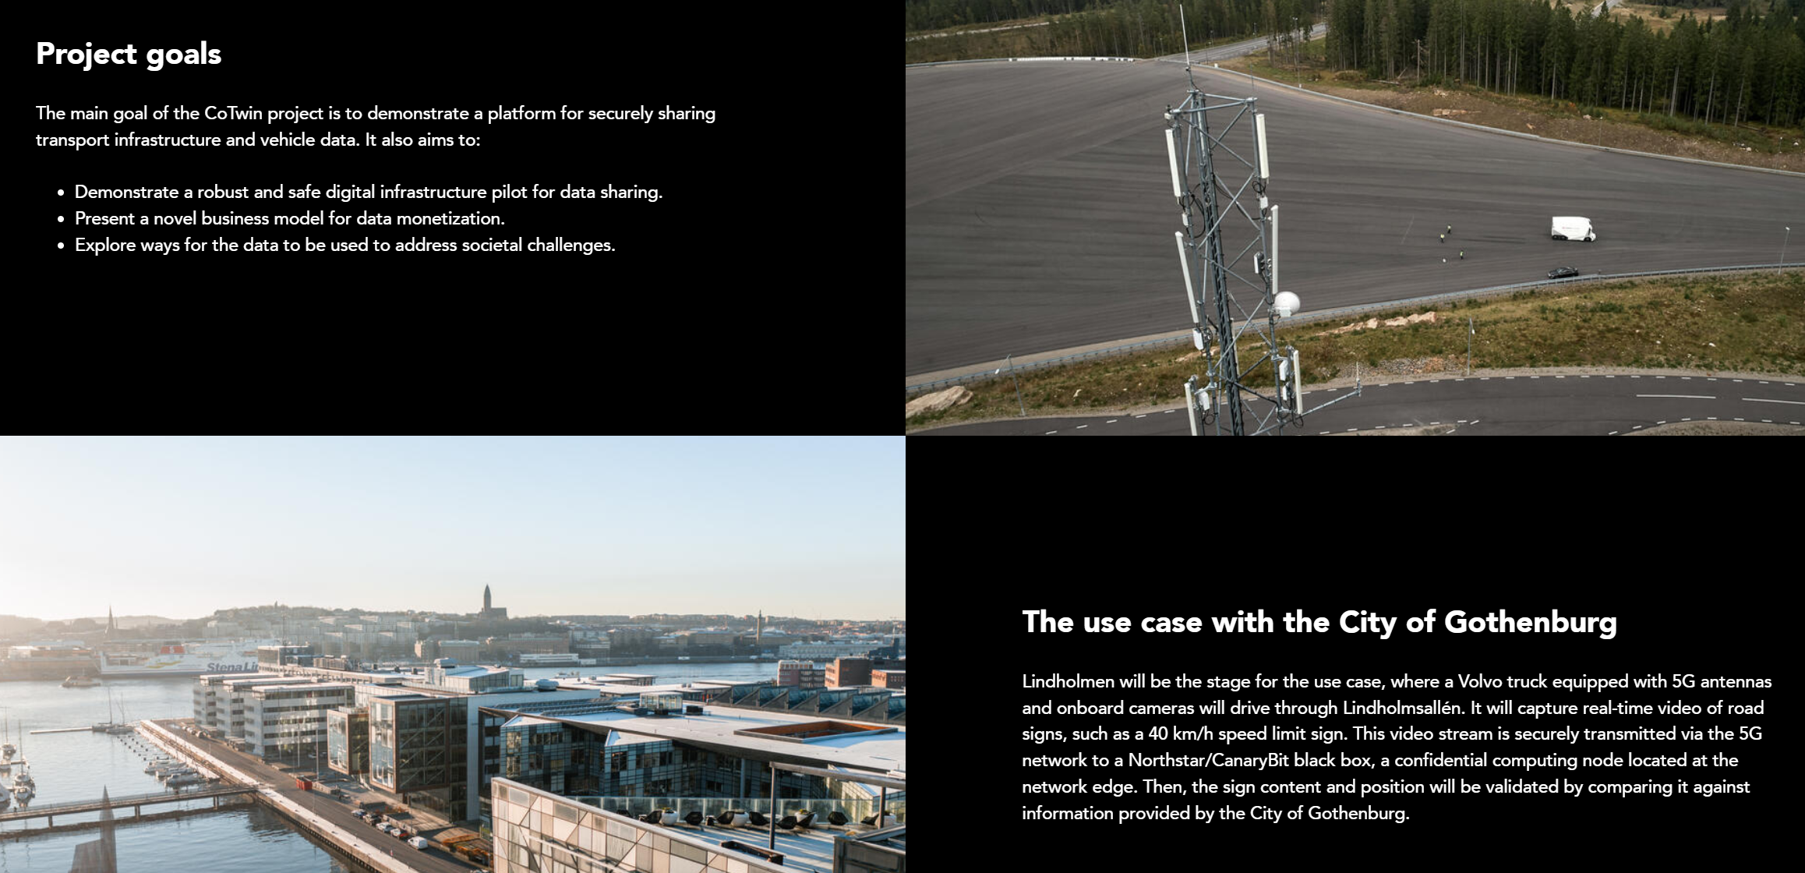
The Problem?
Data sharing is complex, and generating real value often entails significant infrastructure costs. Additionally, legal regulations such as GDPR and security concerns pose obstacles or cause lengthy delays in developing solutions.
Running AI demands substantial data and computing power. Vehicle-based computing, particularly AI processing, is a limited resource. Relying on cloud computing introduces high data transfer costs, latency issues, and further complications related to legal frameworks like GDPR.
Cotwin aims to address these challenges comprehensively.
Notes:
The Challenge
Data sharing is complex, and generating real value often entails significant infrastructure costs. Additionally, legal regulations such as GDPR and security concerns pose obstacles or cause lengthy delays in data sharing and processing.
A clear opportunity to unlock value from data lies in AI, yet running AI demands substantial data and computing power. Vehicle-based computing, particularly AI processing, is a limited resource. Relying on cloud computing introduces high data transfer costs, latency issues, and further complications related to legal frameworks like GDPR.
Cotwin aims to address these challenges comprehensively.

Slide 4
Background
Problem descreption
Traffic and logistic flows are today not optimized in a good way resulting in inefficiencies and low margins in more or less all segments and for all players in the ecosystems. To address these very complex traffic and logistic optimization tasks we need a lot of data from many sources and especially for traffic flow optimization we need real time capabilities.
The potential of using AI to start solving these inefficiencies are then obviously huge but “There is no AI without data” and AI also requires a lot of compute power.
Both these needs are hard to address today. To centralize all data into powerful cloud compute are both expensive due to the large amount of data and the legal implications that it brings in terms of e.g. GDPR or Data act.
To run AI on board a vehicle is today not possible without hug investment and additional cost added to vehicles.
This is exactly the problem that the Cotwin project set out to solve…

Slide 5
The solution
Edge compute with a legal innovation and cross industry collaboration
To adress both data transfer cost, legal challanges and lack of compute an obvious approach would be to create some kind of Edge compute.
Edge compute is used in a variety of cases and the actual edge can be many things, for Volvo it is compute in the truck and for other players it can be in roadside camera unit with some additional computational capability. In all cases to be an edge it needs to be connected to a network and many time wirelessly connected.
Connectivity often leads to Ericsson and they have since many years hade an idea about an ”Edge” compute in their ”edge” which is just behind the base stations. Up until now they have not had a good enough business case to pursue this.
Through a new player (start-up), called Canaribit that has developed a secure compute solution we came in contact with Ericsson and started a dialog aroud the chalanges described in the background slide above
Together with Lindholmen science park as cordinator we applied for a Vinnova project and got it accepted late 2024.

Slide 6
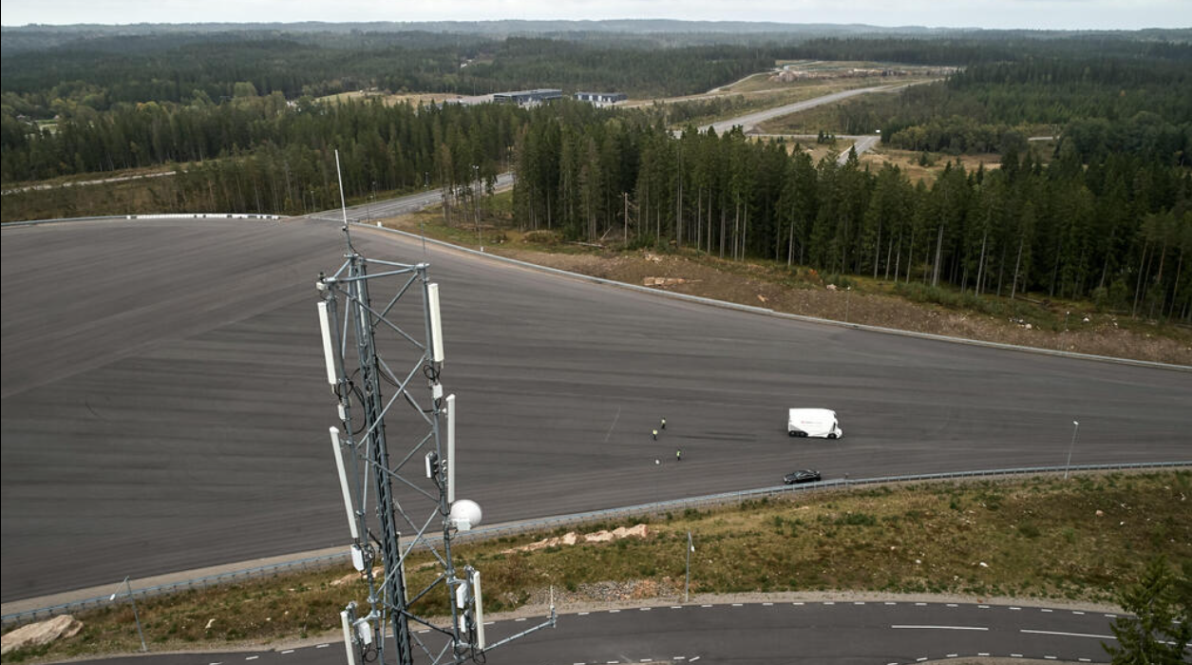
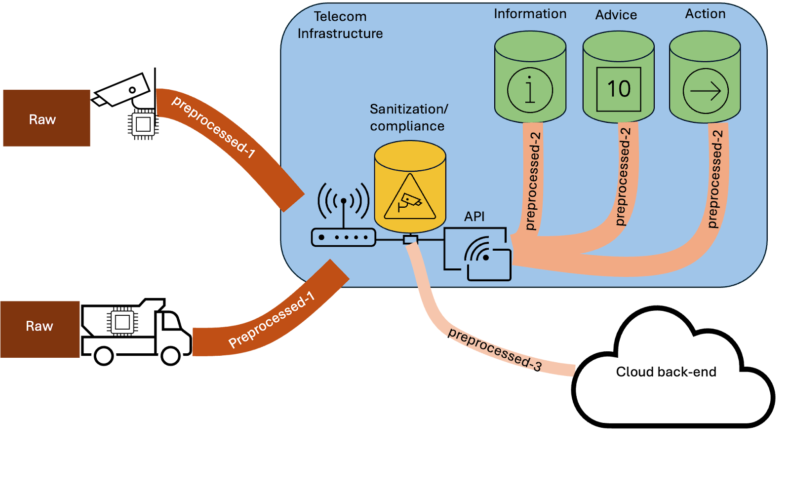
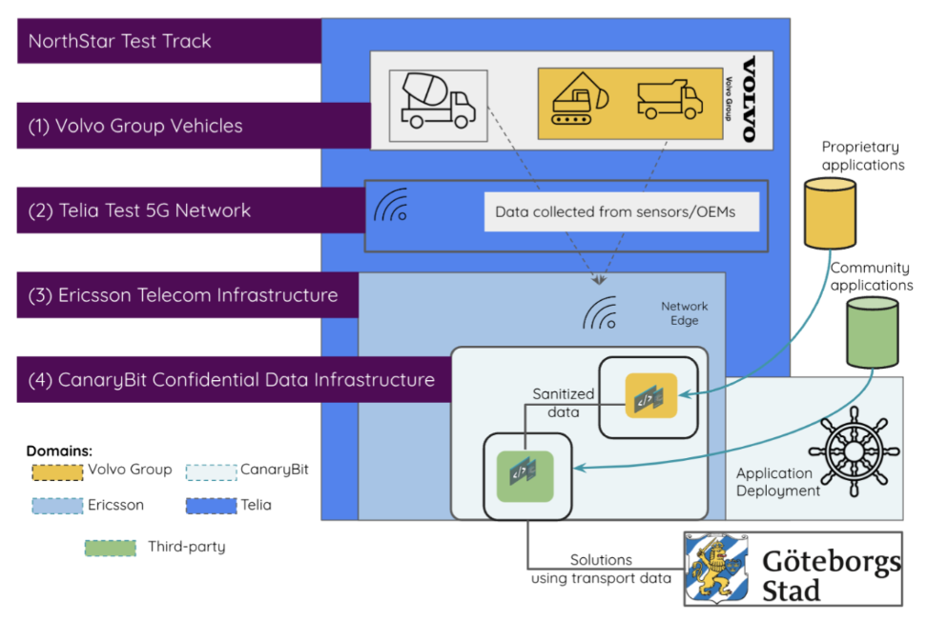
The Solution
To address data transfer costs, legal challenges, and the lack of onboard computing power, we propose implementing edge computing.
Edge computing can take various forms; for Volvo, it involves onboard computing in trucks, while for others, it might be roadside camera units with additional computational capabilities.
In the CoTwin project, the "Edge" refers to computing just behind the base stations, potentially becoming part of future telecom infrastructure provided by Ericsson and operators here represented by Asta Zero (Telia).
This Edge is equipped with state-of-the-art secure computing and data-sharing technology provided by CanaryBit.
Sensor data collected from Volvo Group vehicles and other infrastructure sensors can be processed at this Edge and shared both within the Edge and with traditional cloud computing systems.
A key innovation in this project is a legal investigation conducted with IMY (Integritetsskyddsmyndigheten) to determine if this computing can be considered GDPR-compliant/free. In practice, this would mean that Volvo-specific data processing in CoTwin would be treated as if it were processed within the truck.
Notes:
To address both data transfer cost, legal challanges and lack of compute onboard an obvious approach would be to create some kind of Edge compute.
Edge compute is used in a variety of cases and the actual edge can be many things, for Volvo it is the onboard compute in the truck and for other players it can be in a roadside camera unit with some additional computational capability, etc.
In the CoTwin case the ”Edge” is a compute just behind the base stations which then can be a future telecom infrastructure capabilities from Ericsson to supply to Operators, in our case represented by Asta Zero (Telia).
This Edge is then equipped with a state-of-the art secure compute and data sharing technology, in this project provided by CanaryBit.
In this edge sensor data collected from Volvo Group vehicles and other infrastructure sensor systems can processed and after that shared to others both in this Edge but off course also to our traditional cloud compute.
Another key innovation in the project is a Legal investigation together with IMY (Integritetsskyddsmyndigheten) that will analyze if we could see this compute as GDPR free compute, in practice that would mean that a Volvo specific data processing in CoTwin would be as if it was processed in the Truck.

Slide 7
The Cotwin project
Think big start small
Project CoTWIN will develop and demonstrate an edge compute platform enabling low latency, low cost, high performance compute and secure data/information sharing from/to e.g. Vehicles, road infrastructure and other logistics data sources.
The system combines future telecom infrastructure capabilities (edge compute) from Ericsson and Telia with state-of-the art secure data sharing technology provided by CanaryBit and sensor data collected from Volvo Group vehicles and others.

Slide 8
Technical desciption
Project CoTWIN will develop and demonstrate an edge compute platform enabling low latency, low cost, high performance compute and secure data/information sharing from/to e.g. Vehicles, road infrastructure and other logistics data sources. The system combines future telecom infrastructure capabilities (edge compute) from Ericsson and Telia with state-of-the art secure data sharing technology provided by CanaryBit and sensor data collected from Volvo Group vehicles.
The pictures to the right give a simplified overview of the solution
In the project file general you can find more detailed solution descriptions.

Slide 9
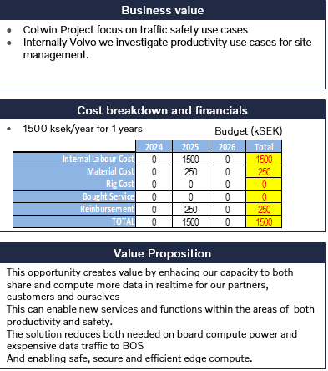
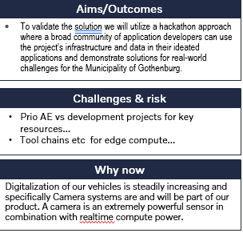

Slide 10
Use cases for vehicle streamed data General not necessarily Volvo investments
First responder – Today research is done with drones as first responder why not Vehicles? Simply share Front Looking Camera (FLC) streams
Live Parking status – Today searching for parking is one of the main contributors to congestions? Use FLC and CMS streams to analyze parking situation especially along roadside.
Live Traffic Look ahead - Use video streams from vehicle in front of you in order to see what is coming. E.g. see through a truck with trailer or see traffic situation x km ahead of you. Volvo can prepare the sending and receiving of this type of streams. The edge compute system takes away any GDPR data (number plates etc…)
Traffic light control optimized on best flow for energy utilization. E.g. Greenlight in perfect time for heavy duty trucks
HD map creation or continuous validation for ADAS/autonomous solutions – Huge amount of data available compared to specific logging vehicles…
Requirement discovery for 6G?
Create a “prosumer” business ecosystem with credits. If you share you can get paid. If you want to use “traffic Look ahead” you pay with this currency…..

Slide 11
Use cases and opportunities
for Volvo outside Cotwin project
Logistic flow optimization – Logistic efficiency is one of society's major inefficiencies today. E.g. Construction logistics has no improved over the last decades. Use FLC or any other cameras to analyze sites like building or road construction of logistic flow sites, for municipals or road authorities any type of crossroads or even event triggered streams/loggs.
Edge compute to improve performance and decrease cost etc. for Teleoperations…

Slide 12
Business models and collaboration
Business models and collaboration: The project will identify key business challenges and create alternative models to access quality data and enable sustainable monetization of transport data. Raw vehicle data often contains noise and sensitive information that must be cleaned before sharing. Processing data near its source reduces transmission costs and increases value. CoTWIN will test a model where sanitized vehicle data is shared with third parties under fair conditions, generating revenue and improving efficiency. The project will develop technologies to securely process and share data, enhance network and energy efficiency, and improve road and transport system use. Results will be demonstrated in Sweden and potentially scaled internationally, aligning with Sweden’s vision for sustainable road transport and digital infrastructure roadmaps.
Notes:
Business models and collaboration: During the project we will analyse and identify the main business hurdles and formulate alternative business and incentive models to provide access to high quality data, as well as investigate pathways towards sustainable monetization of transport data. Akin to raw natural materials, raw data collected from vehicles has no or little added value. Much of it is noise devoid of useful information. At the same time, it may include sensitive personal data that falls under privacy regulations and must be sanitised before being shared with third parties for monetization or merged with other data for further processing. Transferring large volumes of noisy low-value data is not cost-effective. Pre-processing data near the source, using the compute capabilities of telecom infrastructure allows to reduce data transmission costs while increasing the added value of the data. As a result, noisy, low-value, bulky and locally relevant data remains close to the source, while high-value data products with minimal network footprint travel further to the cloud back-end. In CoTWIN, we will use the digital infrastructure demonstrated in the project to test and validate a business model where data owners expose sanitised vehicle data in near real-time to third-party subscribers on FRAND (fair, reasonable and non-discriminatory) conditions [3]. In the long term, this approach will provide additional revenue streams while creating supporting solutions that improve operational efficiency. Technologies, services, processes and enabling technologies: Throughout CoTWIN we will develop a range of technologies and services improving resource utilisation. Some technologies will be developed through technical integration between the project technical partners (Volvo Technology, Telia, Ericsson and CanaryBit). This group, called infrastructure technologies, includes solutions to securely process or share proprietary vehicle data on telecom infrastructure while remaining compliant with privacy regulations. They increase the efficiency of network utilisation by drastically reducing the volume of data transferred throughout the telecommunication network. This also increases energy efficiency, by distributing the computation effort throughout a wide area, as opposed to large-scale data centre processing that increasingly pressures the grid by reserving capacity that could be used for other needs [6]. Another group of technologies, called enabling technologies, will help improve the road network utilisation and overall transportation efficiency. This can be done for example by addressing road congestion, increasing road capacity through automation, digital analysis of road quality, digital speed limiting, and others. CoTWIN will achieve this through a hackathon where a broad community of application developers use the project’s infrastructure to access vehicle data in their applications and demonstrate solutions for real-world challenges for the City of Gothenburg. The digital infrastructure, business model and technologies developed and demonstrated by project CoTWIN in Sweden comprise an integrated solution. Disseminating the project results in high-profile industry events will help connect to other, similar test environments and validate the concept’s feasibility internationally. We will conduct the project and demonstrate its results on the NorthStar test track (year 1), making a technically feasible and economically viable case for using transport data to address societal challenges. Beyond the project, industrial partners plan to continue evolving the solution and refining its business model (years 2 - 3). In the longer run, project results can be scaled nationally and internationally, using the business network and global reach of the large enterprises participating in the project (years 4 - 10). The project’s timeline and ambition align with FFI’s vision, where “Sweden leads the global transition to sustainable road transport”. Moreover, the project’s objectives directly align with the roadmap for digitised road transport systems defined by the Swedish Transport Administration (Trafikverket) [4].

Slide 13
State-of-the-art
Data sharing is challenging but vital for the growing data economy. Various national and international initiatives, like the EU Data Act and Singapore’s Trusted Data Sharing Framework, aim to promote secure data exchange. However, high legal and regulatory costs, along with fragmented technologies, limit practical deployment. Current solutions lack seamless integration and collaboration needed to optimize operations and share data securely across industries.
Notes:
Data sharing is a hard problem, yet it remains an essential ingredient of the emerging data economy. There is an abundance of national and international (EU-level) legislation and initiatives meant to stimulate data sharing across the economy. In the EU, the EU Data Act [2] mandates equipment manufacturers to make the data collected and produced by the equipment available to users and third parties, supporting ecosystems such as the Common European Data Spaces [7]. Other ongoing initiatives like the International Data Spaces [8] and Gaia-X [9] work to bridge the gap between policy, legislation and technical implementation of workable solutions. In Singapore the Infocomm Media Development Authority offers a Trusted Data Sharing Framework and regulatory sandbox [10] to allow businesses and public authorities to experiment with secure data sharing solutions and accelerate innovation. Similarly, in Japan the Ministry of Economy, Trade and Industry and the Information Processing Promotion Agency launched an initiative for interoperable cross-border data infrastructures dubbed the “Ouranos Ecosystem.” [11] Research initiatives such as the European Open Science Cloud [12] are working on developing a cloud infrastructure for sharing data for scientific and public services purposes. The European Commission and national-level research funders actively support research projects developing solutions for data sharing (Harpocrates [13], TITAN [14], Circul8 [15]). Despite the broad range of research and policy initiatives, deployment in practice remains limited and is stifled by high regulatory and legal costs. The industry suffers from a fragmented use of telematics, real-time analytics, and cloud solutions. This prevents the emergence of data-driven solutions capable of effectively improving operational efficiency. The market increasingly demands integrated platforms that can optimise operations across various transport functions, yet current solutions fall short of providing this integration. Existing technologies fail to offer seamless collaboration capabilities, making it difficult for stakeholders to work together effectively and share critical data across the supply chain with secure data processing.

Slide 14
Next step after CoTwin
Another Vinnova application
During autumn we will initiate dialog with the Cotwin partners around the next step of CoTwin.
Initial dialog with Ericsson has started while they are one of the key stakeholders

